Slide 1



A07 Manual CNN – ITAI 1378
Presenter: Ruben Valenzuela

Slide 2


Section 1
Introduction to Convolutional Neural Networks

Slide 3
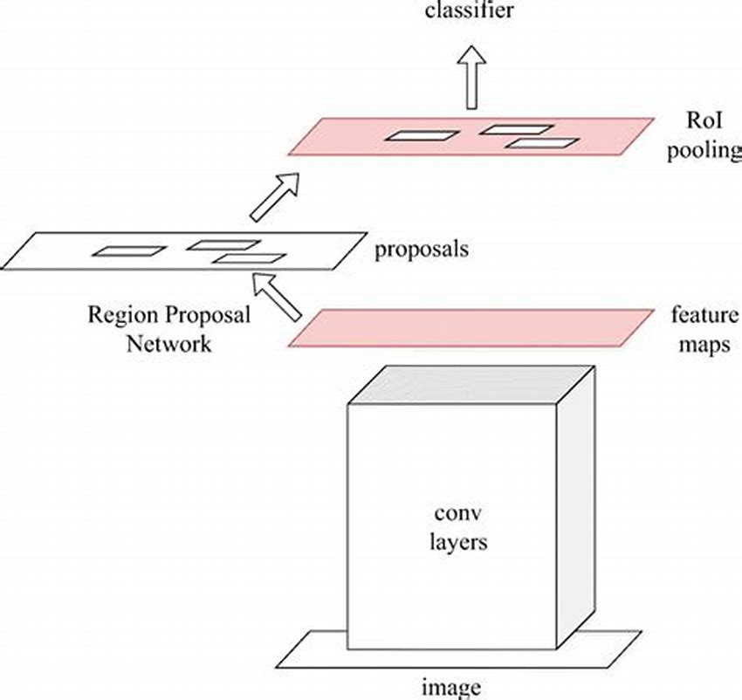
Overview of CNNs
Key Features of CNNs
Convolutional Neural Networks utilize hierarchical feature extraction through multiple layers, enabling efficient processing of visual data, which enhances performance in tasks like image classification and object detection across various applications.

Slide 4
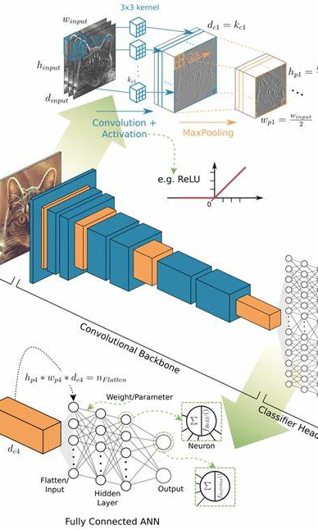
Goals of the Presentation
Simplified CNN Understanding
Aim to clarify CNN concepts for audiences unfamiliar with deep learning intricacies.
Hands-on Convolution Demonstration
Engage attendees through manual convolution, enhancing comprehension of feature detection.
Focus on Edge Detection
Highlight the significance of edge detection in image processing and CNN functionality.

Slide 5
Section 2
Understanding the Image and Filters

Slide 6


Our Simplified Image (5×5)
Central Plus Shape
The 5×5 matrix uses binary values to denote pixel colors, making it easier to comprehend the image's structure and its significance for convolutional processes in CNNs.
The deliberate arrangement of pixels forms a recognizable plus shape, which serves as a critical feature for demonstrating edge detection and the effectiveness of convolutional filters in image analysis.
Binary Pixel Representation

Slide 7


Our Filters (3×3)
Function of Filters
Horizontal Edge Detection
Filters in CNNs are essential for extracting features, enhancing image clarity, and improving classification accuracy in computer vision tasks.
Filter B focuses on horizontal transitions, effectively identifying edges by contrasting pixel intensity gradients from top to bottom.
Vertical Edge Detection
Filter A emphasizes vertical transitions, highlighting edges by contrasting pixel intensity gradients from left to right.

Slide 8
Section 3
Manual Convolution Process

Slide 9
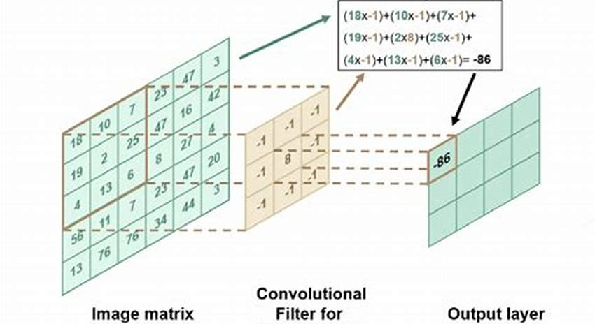
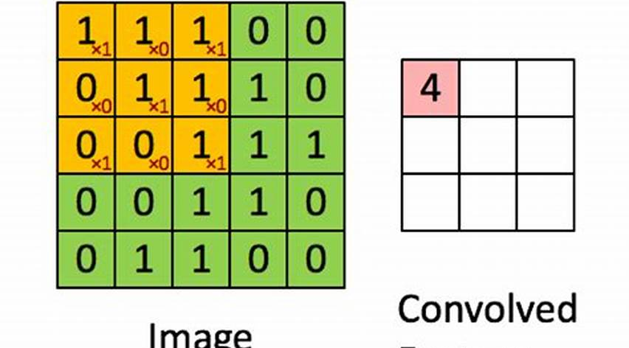
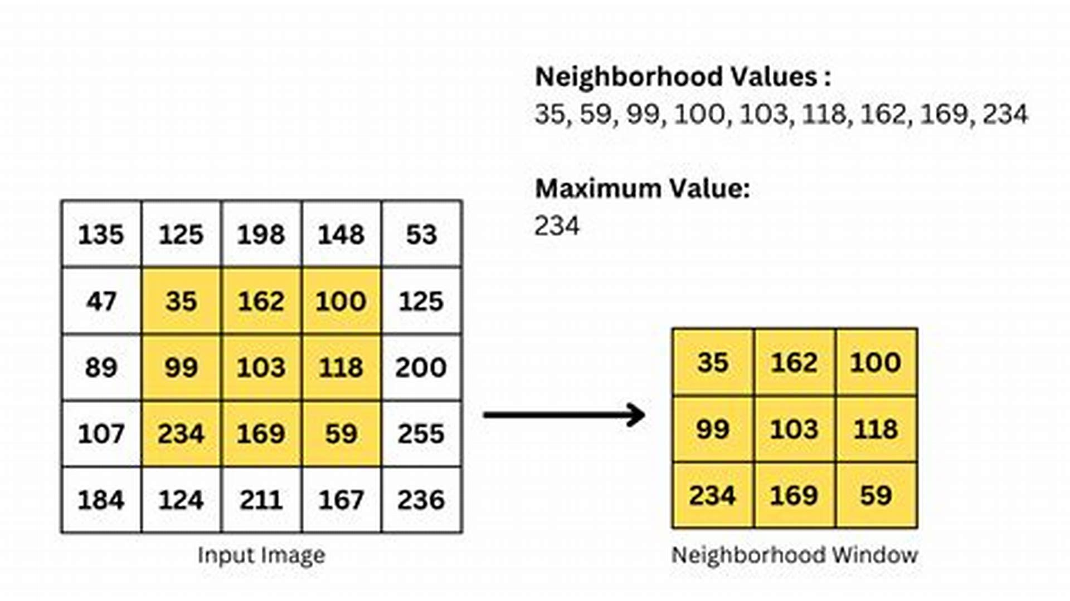
Convolution Steps
Filter Placement Technique
Element-wise Multiplication Process
Iterative Filter Movement
The initial step involves accurately positioning the filter over the image, ensuring that the filter's dimensions align with the selected pixel region for effective feature extraction.
This crucial step entails multiplying each filter value by the corresponding pixel value, followed by summing these products to yield a single output value for the convolution operation.
The filter is systematically shifted across the image, one pixel at a time, allowing for comprehensive coverage and the generation of a complete feature map that captures essential image characteristics.

Slide 10
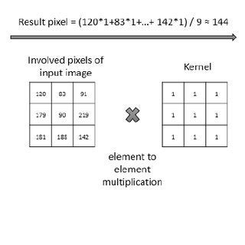
Sample Convolution Results
Convolution Output Analysis
The convolution results from both filters illustrate the effectiveness of edge detection, with Filter A highlighting vertical edges and Filter B emphasizing horizontal edges, crucial for understanding feature extraction in CNNs.

Slide 11

Interpretation of Results
01
02
Significance of Filter Outputs
Complementary Edge Detection
The results from Filter A and Filter B reveal critical insights into edge detection, showcasing how vertical and horizontal features are distinctly represented in the image analysis.
Analyzing both filters together enhances understanding of the image structure, confirming the convolutional process's effectiveness in identifying and delineating key visual features.

Slide 12
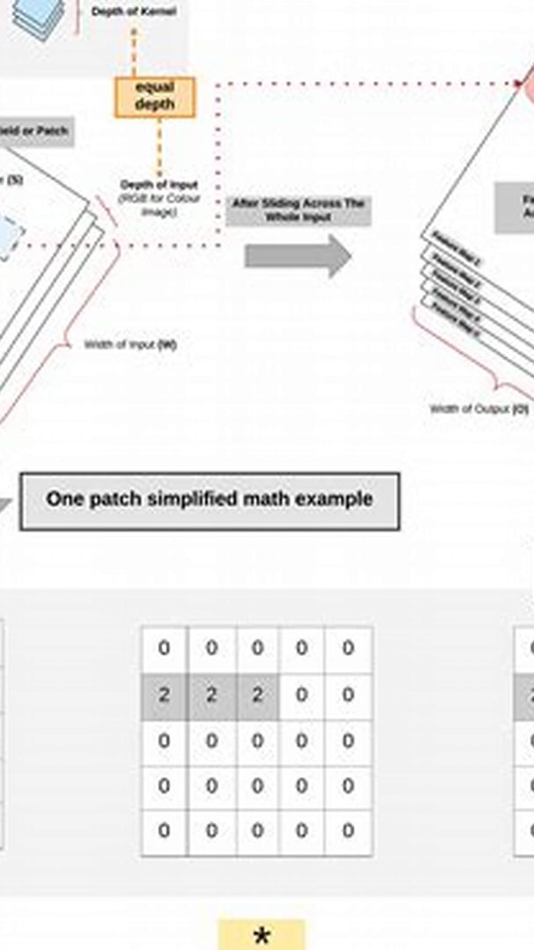





Conclusion
Core Principles Recap
Understanding CNNs is essential for grasping advanced deep learning applications and their impact.
Manual Convolution Insights
The exercise illustrates fundamental feature detection methods used in CNN architectures.
Future Learning Pathways
Mastery of these concepts lays the groundwork for exploring sophisticated neural network models.

Slide 13
Thank You
W213684051@student.hccs.edu

